Slide 1
Module 14: Debugging EIM jobs
Siebel EIM training
Notes:
Invoking Enterprise Integration Manager
COMPANY CONFIDENTIAL AND PROPRIETARY INFORMATION — DUPLICATION IS PROHIBITED
35.<number>
Time: Lecture: 35 – 40 minutes; labs: 70 – 95 minutes
Intent: To explain how to debug EIM jobs.
Flow: Interface table structure; temporary columns; process for loading and verifying EIM tables; configuration file and associated options; EIM processing; disabling transaction logging for initial loads; invoking an EIM task; verifying EIM tasks; and clearing out EIM tables.
Key Terms:
Interface table (EIM table)
T_ column
.ifb file (configuration file)
Server Manager
IF_ROW_STAT column
Please note: Faculty-specific notes are italicized.

Slide 2

Module Objectives
After completing this module you will be able to:
  Provide EIM run status.
  Decipher IF_ROW_STAT values.
  Make use of T_... Columns.
  Set appropriate log levels and read log files.
Why you need to know:
  To successfully debug a failed EIM process.
Notes:
Invoking Enterprise Integration Manager
COMPANY CONFIDENTIAL AND PROPRIETARY INFORMATION — DUPLICATION IS PROHIBITED
35.<number>

Slide 3
Debugging?
Application level
  Check EIM process state
Database level
  Check IF_ROW_STAT of interface table(s)
  Check T_ … columns of interface table(s)
Log files
  Log levels
  EIM process passes
Notes:
Invoking Enterprise Integration Manager
COMPANY CONFIDENTIAL AND PROPRIETARY INFORMATION — DUPLICATION IS PROHIBITED
35.<number>
Verify EIM task using:
Client application to view data
SQL against the EIM and base tables
Log files to troubleshoot

Slide 4
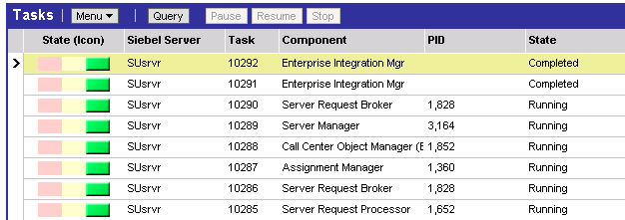
EIM process state
Navigate to Administration - Server Management > Jobs
Query by relevant Task or Component = ‘Enterprise Integration Mgr’
State
Status
Notes:
Invoking Enterprise Integration Manager
COMPANY CONFIDENTIAL AND PROPRIETARY INFORMATION — DUPLICATION IS PROHIBITED
35.<number>
One can also view the logs in the application.
Failures and errors on secondary tables of little importance may be encountered. EIM will do as much work as it can and provide notification of any errors. When errors are encountered, they may not indicate a failure and should be investigated.

Slide 5
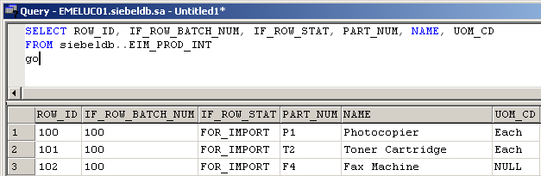
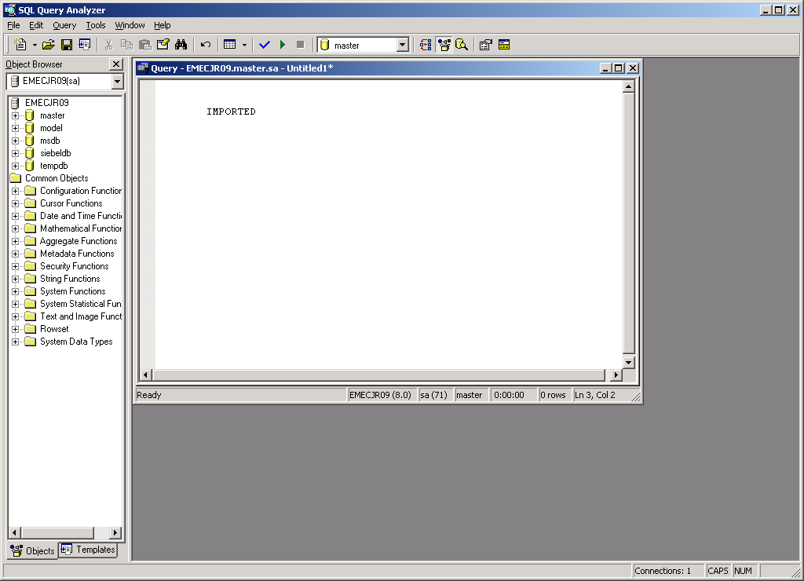
IF_ROW_STAT
Check distinct IF_ROW_STAT columns
  For given batch range(s)
  in each interface table(s)
FOR_IMPORT specifies that the row is for import; FOR_DELETE specifies delete
IF_ROW_BATCH_NUM | Row_ID | IF_ROW_STAT | NAME
100 | 1 | FOR_IMPORT | Photocopier
100 | 2 | FOR_IMPORT | Fax Machine
200 | 1 | FOR_IMPORT | Shredder
200 | 2 | FOR_IMPORT | Toner Cartridge
IF_ROW_STAT changes for relevant batch in EIM table
Notes:
Invoking Enterprise Integration Manager
COMPANY CONFIDENTIAL AND PROPRIETARY INFORMATION — DUPLICATION IS PROHIBITED
35.<number>
Positioning Slide.

Slide 6
IF_ROW_STAT values
Post EIM process IF_ROW_STAT values in interface tables
Value | Comment
AMBIGUOUS | There are two rows in the base table that have the same user key but different conflict IDs. EIM cannot distinguish these rows.
DUP_RECORD_EXISTS | The row exactly matches rows that already exist in the destination tables. This error occurs in Step 8. Note that a row may have a duplicate in the target base table, but not in other destination base tables. In this situation, EIM adds the new relation (a child or intersection table) in the other destination base tables, and does not mark the EIM table row as a duplicate.
Notes:
Invoking Enterprise Integration Manager
COMPANY CONFIDENTIAL AND PROPRIETARY INFORMATION — DUPLICATION IS PROHIBITED
35.<number>
Self explanatory slide

Slide 7
IF_ROW_STAT values (cntd.)
Value | Comment
DUP_RECORD_IN_EIM_TBL | The row was eliminated because it is a duplicate (has the same user key) of another row in the EIM table with the same batch number. In this case, MIN(ROW_ID) is the record processed, and the other records with the same user key are marked as DUP_RECORD_IN_EIM_TBL. Do not confuse DUP_RECORD_IN_EIM_TBL with DUP_RECORD_EXISTS. DUP_RECORD_EXISTS status indicates that the same record already exists in the base table, while DUP_RECORD_IN_EIM_TBL status indicates that there are two or more EIM table records having the same user key values.
Notes:
Invoking Enterprise Integration Manager
COMPANY CONFIDENTIAL AND PROPRIETARY INFORMATION — DUPLICATION IS PROHIBITED
35.<number>
Self explanatory slide

Slide 8
IF_ROW_STAT values (cntd.)
Value | Comment
FOREIGN_KEY | A required foreign key column in the target table could not be resolved. This error occurs in Step 4.
IMPORTED | The row was successfully processed against all its destination base tables. This status is set after the import has been completed. You can check the import status by using database commands to query the appropriate EIM tables for rows whose IF_ROW_STAT value is not equal to IMPORTED. The result is a list of rows that were not successfully imported.
Notes:
Invoking Enterprise Integration Manager
COMPANY CONFIDENTIAL AND PROPRIETARY INFORMATION — DUPLICATION IS PROHIBITED
35.<number>
Self explanatory slide

Slide 9
IF_ROW_STAT values (cntd.)
Value | Comment
IMPORT_REJECTED | A user-specified filter query failed for this row. This error occurs in Step 3 if the user has specified FILTER QUERY expressions.
IN_PROGRESS | In Step 1, EIM sets IF_ROW_STAT to this initial value for all rows in the batch. If rows still have this status value after EIM exits, a failure occurred that aborted processing for this table.
NON_UNIQUE_UKEYS | The user key was not unique in all the user key specifications on the table.
Notes:
Invoking Enterprise Integration Manager
COMPANY CONFIDENTIAL AND PROPRIETARY INFORMATION — DUPLICATION IS PROHIBITED
35.<number>
Self explanatory slide

Slide 10
IF_ROW_STAT values (cntd.)
Value | Comment
PARTIALLY_IMPORTED | The row did not fail for the target table (although it may have been a duplicate), but did fail during processing of a secondary base table. This status is set after the import has completed.
PICKLIST_VALUE | A required picklist value in the target table could not be resolved. This error occurs for NULL or invalid bounded picklist values in Step 4.
REQUIRED_COLS | One or more required columns for the target table were NULL. This error occurs for missing user key columns in Step 7, or when inserting new rows in Step 9.
Notes:
Invoking Enterprise Integration Manager
COMPANY CONFIDENTIAL AND PROPRIETARY INFORMATION — DUPLICATION IS PROHIBITED
35.<number>
Self explanatory slide

Slide 11
IF_ROW_STAT values (cntd.)
Value | Comment
ROLLBACK | EIM encountered an error, such as an SQL database failure, and rolled back the transaction. This status is only used when ROLLBACK ON ERROR = TRUE.
SQL_ERROR | An SQL error occurred during an attempt to import this row. This error occurs for rows processed when Enable Transaction Logging is set to TRUE.
DELETED | Rows marked for deletion were successfully processed.
EXPORTED | Data was successfully exported
Notes:
Invoking Enterprise Integration Manager
COMPANY CONFIDENTIAL AND PROPRIETARY INFORMATION — DUPLICATION IS PROHIBITED
35.<number>
Self explanatory slide

Slide 12
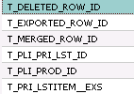
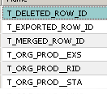
EIM T_ Columns
All interface tables have T_ columns to hold temporary values and status used during processing step
Temporary values
Notes:
Invoking Enterprise Integration Manager
COMPANY CONFIDENTIAL AND PROPRIETARY INFORMATION — DUPLICATION IS PROHIBITED
35.<number>
T_ columns that end with __STA are status columns and can provide additional troubleshooting assistance. Refer to the Siebel Enterprise Integration Manager Administration Guide.

Slide 13
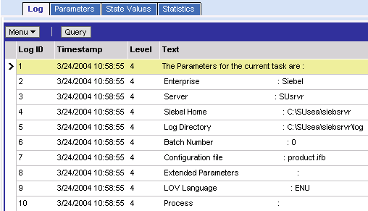
Log files
Navigate to Administration - Server Management > Tasks
  Query to view progress
  Review Task Information Log
Notes:
Invoking Enterprise Integration Manager
COMPANY CONFIDENTIAL AND PROPRIETARY INFORMATION — DUPLICATION IS PROHIBITED
35.<number>
This slide illustrates how to monitor an EIM task using Server Manager.

Slide 14
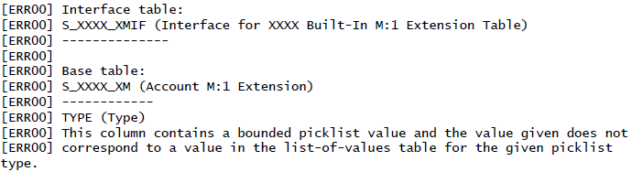
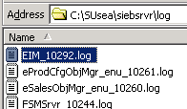
Verify Log Files
Use log files to troubleshoot
Error Log file
Error information
Corresponds to task number
Notes:
Invoking Enterprise Integration Manager
COMPANY CONFIDENTIAL AND PROPRIETARY INFORMATION — DUPLICATION IS PROHIBITED
35.<number>

Slide 15
Log Levels
Error Flag - detailed explanation of rows that were not successfully processed.
SQL Trace Flag - SQL statements that make up the EIM task.
Trace Flag – Contain logs of various EIM operations.
Recommendation: Set flags to1-8-9 for debugging.
Description | Error Flag | SQL Trace Flag | Trace Flag
Display errors and unused foreign keys | 1 | 1 | 1
Determine SQL performance | 1 | 8 | 3
Determine optimal batch size and monitor performance in a particular step | 0 | 0 | 1
Notes:
Invoking Enterprise Integration Manager
COMPANY CONFIDENTIAL AND PROPRIETARY INFORMATION — DUPLICATION IS PROHIBITED
35.<number>
SQL Debug Flags (1, 2, 4, and 8)
Available Trace flags include 1, 2, 4, 8, and 32. To activate multiple trace flags, set the Trace Flags parameter to the sum of individual trace flag numbers. For example, to log trace flags 2 and 4, set the Trace Flags parameter to 6.

Slide 16
Invalid .ifb file
The EIM Log will indicate if the IFB File specified in the EIM Task cannot be found or if the specified file has some problem in how it is written.
  An error will occur if there are carriage returns in the wrong places, or if an invalid parameter setting is specified.
One of the following error generic message may appear in the EIM Log.
  SBL-EIM-00206: Failed to run initial process
  SBL-EIM-00204: Invalid configuration file to load
It may be found with another more specific message to indicate the actual error.
  Ex. Error 302: Child section Update Statistics First Batch not found
  Ex. Error 304: No value part of the assignment.
Notes:
Invoking Enterprise Integration Manager
COMPANY CONFIDENTIAL AND PROPRIETARY INFORMATION — DUPLICATION IS PROHIBITED
35.<number>

Slide 17
No Rows for given batch
If an IFB file indicates processing for a batch, but there are no rows with that batch number in the EIM table, a warning will be displayed in the EIM Log.
  Example:
    Process [LOAD_POSITIONS BATCH SET 1] had all rows fail
    on EIM_POSITION for batch 220001 in step 1, pass 300:
    No rows exist in IF table for this batch. (severity 2, table aborted)
    No rows exist in this interface table which correspond to this batch number.
    This means that no rows exist to be imported from this interface table.
    Since there was a problem with the configuration of this interface table, processing was discontinued. However, processing of other interface tables will continue.
IF_ROW_BATCH_NUM column does not align to a matching batch for processing in the .ifb file, then No Rows For Given Batch will be thrown
Notes:
Invoking Enterprise Integration Manager
COMPANY CONFIDENTIAL AND PROPRIETARY INFORMATION — DUPLICATION IS PROHIBITED
35.<number>

Slide 18
Deadlock
A Deadlock means the table is locked at the database level.
When a deadlock occurs, the IF_ROW_STAT value will not be correct.
  The IF_ROW_STAT value may stay at “IN_PROGRESS” if EIM is unable to process the record due to a deadlock.
  A deadlock can be identified by looking at the EIM Log file.
  The following is an example of an excerpt of the EIM Log for a deadlock on S_ORG_EXT:
    [IBM][CLI Driver][DB2] SQL0904N Unsuccessful execution caused by an unavailable resource. Reason code: "00C200EA", type of resource: "00000210", and resource name: "D21201 .H1465000.00000001 ". SQLSTATE=57011
  This error would indicate two processes were trying to update the same record – such as one from UI and EIM process or two EIM processes simultaneously. Attempt to re-run and / or engage a DBA to investigate why the deadlock occurred.
Notes:
Invoking Enterprise Integration Manager
COMPANY CONFIDENTIAL AND PROPRIETARY INFORMATION — DUPLICATION IS PROHIBITED
35.<number>

Slide 19
Foreign Key Error
For loading data from EIM_ACCOUNT to S_ORG_BU, the foreign key on S_ORG_BU to the S_ORG_EXT record is a required field.
This will result in a “PARTIALLY_IMPORTED” status on the EIM Records with this error.
In the EIM Log file, search for the batch number which has this error status.
  The following shows that batch number 0 had 1 record with a foreign key problem on S_ORG_BU.
    Process [Process S_ORG_EXT Batch Set 1] had 1 row fail
    on EIM_ACCOUNT for batch 0 in step 4, pass 185:
    Failed to resolve foreign key value. (severity 7)
  It will then be followed by which EIM columns is causing the problem, as well as which base table column it maps to.
    Interface table:
    EIM_ACCOUNT (EIM_ACCOUNT)
    -----------
    ACCNT_BI (Name)
    NAME (Name)
    LOC (Site)
    Base table:
    S_ORG_BU (Business Unit Accounts)
    ---------
    ORG_ID (Organization Id)
Notes:
Invoking Enterprise Integration Manager
COMPANY CONFIDENTIAL AND PROPRIETARY INFORMATION — DUPLICATION IS PROHIBITED
35.<number>

Slide 20
Picklist Error
When an IF_ROW_STAT value equals “PICKLIST_VALUE”, the EIM Log file will provide more information as to which column is having this error.
A picklist error will cause the rows with that error to be eliminated from processing for that base table.
In the EIM Log file, search for the batch number which has this error status.
  The following shows that batch number 0 had 1 record with a picklist problem.
    Process [Process S_ORG_EXT Batch Set 1] had 1 row fail
    on EIM_ACCOUNT for batch 0 in step 4, pass 151:
    Invalid value for bounded picklist column. (severity 7)
  It will then be followed by which EIM column is causing the problem, as well as which base table column it maps to.
    Interface table:
    EIM_ACCOUNT
    SEG_MKT_SEG_NAME
    Base table:
    S_ACCNT_MKT_SEG
    MKT_SEG_VAL
Notes:
Invoking Enterprise Integration Manager
COMPANY CONFIDENTIAL AND PROPRIETARY INFORMATION — DUPLICATION IS PROHIBITED
35.<number>

Slide 21
Summary
This module showed you how to:
  Provide EIM run status.
  Decipher IF_ROW_STAT values.
  Make use of T_... Columns.
  Set appropriate log levels and read log files.
Notes:
Invoking Enterprise Integration Manager
COMPANY CONFIDENTIAL AND PROPRIETARY INFORMATION — DUPLICATION IS PROHIBITED
35.<number>

Slide 22
Lab
In the labs you will:
  Investigate on specific problem(s) and how to go about solving them.
Notes:
Invoking Enterprise Integration Manager
COMPANY CONFIDENTIAL AND PROPRIETARY INFORMATION — DUPLICATION IS PROHIBITED
35.<number>
See lab instructions for details.

